Slide 1
ACID BASES AND SALTS Common properties of Acids and Bases
CHAPTER NUMBER 2

Slide 2
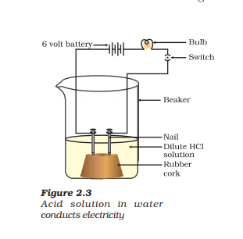
WHAT DO ALL ACIDS AND ALL BASES HAVE IN COMMON?
Step 1:Take solutions of glucose, alcohol, hydrochloric acid, sulphuric acid, etc.
Step 2: Fix two nails on a cork, and place the cork in a 100 mL beaker.
Step 3:Connect the nails to the two terminals of a 6 volt battery through a bulb and a switch, as shown in Fig. 2.3.
Step 4:Now pour some dilute HCl in the beaker and switch on the current.
Step 5:Repeat with dilute sulphuric acid.
Notes:
Step 1:Take solutions of glucose, alcohol, hydrochloric acid, sulphuric acid, etc.
Step 2: Fix two nails on a cork, and place the cork in a 100 mL beaker.
Step 3:Connect the nails to the two terminals of a 6 volt battery through a bulb and a switch, as shown in Fig. 2.3.
Step 4:Now pour some dilute HCl in the beaker and switch on the current.
Step 5:Repeat with dilute sulphuric acid.
What do you observe?
Repeat the experiment separately with glucose and alcohol solutions. What do you observe now?
Observe if the bulb glow in all cases?
Inference
The bulb will start glowing in the case of acids, as shown in Fig. 2.3. But you will observe that glucose and alcohol solutions do not conduct electricity. Glowing of the bulb indicates that there is a flow of electric current through the solution. The electric current is carried through the acidic solution by ions. Acids contain H+ ion as cation and anion such as Cl– in HCl, NO3 – in HNO3 , SO2– 4 in H2 SO4 , CH3COO– in CH3COOH. Since the cation present in acids is H+ , this suggests that acids produce hydrogen ions, H+ (aq), in solution, which are responsible for their acidic properties. Repeat the same Activity using alkalis such as sodium hydroxide, calcium hydroxide, etc. What can you conclude from the results of this Activity?

Slide 3
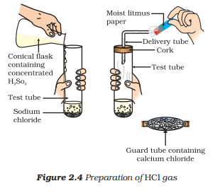
What Happens to an Acid or a Base in a Water Solution?
Base
+
Acid
Salt
+
Water
HX
+
MOH
MX
+
HOH
H⁺(aq)
+
OH⁻(aq)
H₂O (l)
Notes:
Step 1: Take about 1g solid NaCl in a clean and dry test tube and set up the apparatus as shown in Fig. 2.4.
Step 2:Add some concentrated sulphuric acid to the test tube.
What do you observe? Is there a gas coming out of the delivery tube?
Step 3:Test the gas evolved successively with dry and wet blue litmus paper.
Note In which case does the litmus paper change colour?
On the basis of the above Activity, what do you infer about the acidic character of: (i) dry HCl gas (ii) HCl solution?
Now as we have identified that all acids generate H+ (aq) and all bases generate OH– (aq), we can view the neutralisation reaction as follows –
Acid + Base → Salt + Water
H X + M OH → MX+ HOH
H+ (aq) + OH – (aq) → H2O(l)
INFERENCE:
This experiment suggests that hydrogen ions in HCl are produced in the presence of water. The separation of H+ ion from HCl molecules cannot occur in the absence of water. HCl + H2O → H3O+ + Cl– Hydrogen ions cannot exist alone, but they exist after combining with water molecules. Thus hydrogen ions must always be shown as H+ (aq) or hydronium ion (H3O+ ). H+ + H2O → H3O+ We have seen that acids give H3O+ or H+ (aq) ion in water. Let us see what happens when a base is dissolved in water. NaOH(s)  → H O2 Na+ (aq) + OH– (aq)
KOH(s)= K (aq)+OH (aq)
– Mg(OH)2 (s) +H2O = Mg2+(aq)+2OH– (aq)
Bases generate hydroxide (OH– ) ions in water. Bases which are soluble in water are called alkalis

Slide 4
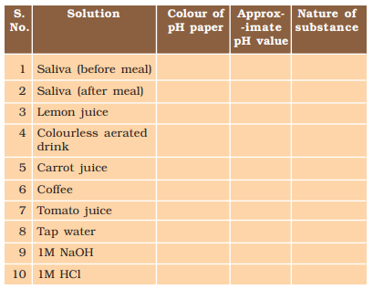
Activity
Step 1:Test the pH values of solutions in Table
Step 2:Record your observations.
Notes:
Step 1:Test the pH values of solutions in Table
Step 2:Record your observations.
What is the nature of each substance on the basis of your observations?
INFERENCE
The strength of acids and bases depends on the number of H+ ions and OH– ions produced, respectively. If we take hydrochloric acid and acetic acid of the same concentration, say one molar, then these produce different amounts of hydrogen ions. Acids that give rise to more H+ ions are said to be strong acids, and acids that give less H+ ions are said to be weak acids. Can you now say what weak and strong bases are?

Slide 5
Importance of pH in Everyday Life
Are plants and animals pH sensitive?
What is the pH of the soil in your backyard?
Notes:
Add some images related to the content.
1)Are plants and animals pH sensitive?
Our body works within the pH range of 7.0 to 7.8. Living organisms can survive only in a narrow range of pH change. When pH of rain water is less than 5.6, it is called acid rain. When acid rain flows into the rivers, it lowers the pH of the river water. The survival of aquatic life in such rivers becomes difficult.
2)What is the pH of the soil in your backyard?
Plants require a specific pH range for their healthy growth. To find out the pH required for the healthy growth of a plant, you can collect the soil from various places and check the pH in the manner described below in Activity 2.12. Also, you can note down which plants are growing in the region from which you have collected the soil.

Slide 6
pH in our digestive system
pH change as the cause of tooth decay
Self defence by animals and plants through chemical warfare
Notes:
3)pH in our digestive system
It is very interesting to note that our stomach produces hydrochloric acid. It helps in the digestion of food without harming the stomach. During indigestion the stomach produces too much acid and this causes pain and irritation. To get rid of this pain, people use bases called antacids. One such remedy must have been suggested by you at the beginning of this Chapter. These antacids neutralise the excess acid. Magnesium hydroxide (Milk of magnesia), a mild base, is often used for this purpose.
4) pH change as the cause of tooth decay
Tooth decay starts when the pH of the mouth is lower than 5.5. Tooth enamel, made up of calcium hydroxyapatite (a crystalline form of calcium phosphate) is the hardest substance in the body. It does not dissolve in water, but is corroded when the pH in the mouth is below 5.5. Bacteria present in the mouth produce acids by degradation of sugar and food particles remaining in the mouth after eating. The best way to prevent this is to clean the mouth after eating food. Using toothpastes, which are generally basic, for cleaning the teeth can neutralise the excess acid and prevent tooth decay.
5)Self defence by animals and plants through chemical warfare
Have you ever been stung by a honey-bee? Bee-sting leaves an acid which causes pain and irritation. Use of a mild base like baking soda on the stung area gives relief. Stinging hair of nettle leaves inject methanoic acid causing burning pain.

Slide 7
CONCLUSION
In this part we learnt about:
What do all acids and all bases have in common?
What Happens to an Acid or a Base in a Water Solution?
Importance of pH in Everyday Life

